Slide 1
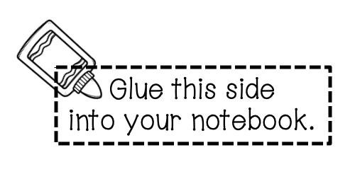
© Flip4Math 2021

Slide 2
x
÷
6th Grade Math
+
-

